Slide 1
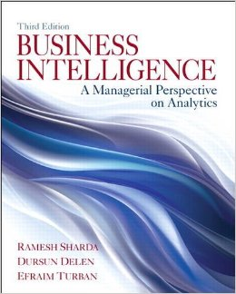
Business Intelligence: A Managerial Perspective
on Analytics
Chapter 6:
Big Data and Analytics

Slide 2
Learning Objectives
Learn what Big Data is and how it is changing the world of analytics
Understand the motivation for and business drivers of Big Data analytics
Become familiar with the wide range of enabling technologies for Big Data analytics
Learn about Hadoop and MapReduce as they relate to Big Data analytics
Understand the role of and capabilities/skills for data scientist as a new analytics profession
Compare and contrast the complementary uses of data warehousing and Big Data

Slide 3
Big Data - Definition and Concepts
Big Data means different things to people with different backgrounds and interests
Traditionally, “Big Data” = massive volumes of data
E.g., volume of data at CERN, NASA, Google, …
Where does the Big Data come from?
Everywhere! Web logs, RFID, GPS systems, sensor networks, social networks, Internet-based text documents, Internet search indexes, detail call records, astronomy, atmospheric science, biology, genomics, nuclear physics, biochemical experiments, medical records, scientific research, military surveillance, multimedia archives, …

Slide 4
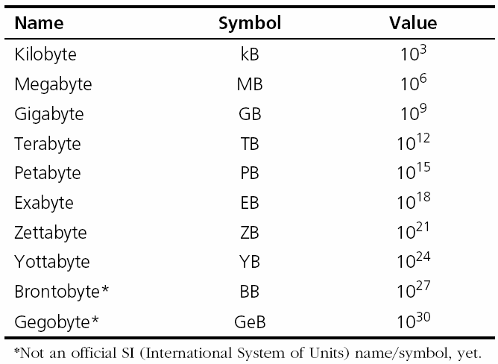
Technology Insights 6.1 The Data Size Is Getting Big, Bigger, …
Hadron Collider - 1 PB/sec
Boeing jet - 20 TB/hr
Facebook - 500 TB/day
YouTube – 1 TB/4 min
The proposed Square Kilometer Array telescope (the world’s proposed biggest telescope) – 1 EB/day
Internet produces 1 EB/day
(250 million DVD’s)

Slide 5
Big Data - Definition and Concepts
Big Data is a misnomer… it’s much more than just “big”
The 3 Vs that define Big Data
Volume (0.8 ZB in 2009 / 1.8 ZB in 2011)
Variety (DB’s, email, XML, clickstreams, RFID, video, audio, etc.)
Social Network Analysis of your “Friends” http://www.touchgraph.com/facebook
Velocity (reacting quickly enough is the major challenge today)
https://player.vimeo.com/video/123728123
Veracity (added by IBM – accuracy, quality, trustworthiness)
Variability (different from variety? Not a new “V” to me)
Value (not necessarily another “V” to me)

Slide 6
Big Data - Definition and Concepts
Big Data is not new!
Traditionally, “Big Data” = massive volumes of data
Volume of data at CERN, NASA, Google, …
Where does the Big Data come from?
Everywhere! Web logs, RFID, GPS systems, sensor networks, social networks, Internet-based text documents, Internet search indexes, detail call records, astronomy, atmospheric science, biology, genomics, nuclear physics, biochemical experiments, medical records, scientific research, military surveillance, multimedia archives, …

Slide 7
Fundamentals of Big Data Analytics
Big Data by itself, regardless of the size, type, or speed, is worthless
Big Data + “big” analytics = Big Value
With the value proposition, Big Data also brought about big challenges
Effectively and efficiently capturing, storing, and analyzing Big Data
New breed of technologies needed (developed or purchased or hired or outsourced …)

Slide 8
Big Data Considerations
You can’t process the amount of data that you want to because of the limitations of your current platform.
You can’t include new/contemporary data sources (e.g., social media, RFID, Sensory, Web, GPS, textual data) because it does not comply with the data storage schema
You need to (or want to) integrate data as quickly as possible to be current on your analysis.
You want to work with a schema-on-demand (as opposed to a relational DB like a data warehouse) data storage paradigm because of the variety of data types involved.
The data is arriving so fast at your organization’s doorstep that your traditional analytics platform cannot handle it.

Slide 9
Critical Success Factors for Big Data Analytics

Slide 10
Enablers of Big Data Analytics
In-memory analytics
Storing and processing the complete data set in RAM
In-database analytics
Placing analytic procedures close to where data is stored
Grid computing & MPP
Use of many machines and processors in parallel (MPP - massively parallel processing)
Appliances
Combining hardware, software, and storage in a single unit for performance and scalability

Slide 11

Challenges of Big Data Analytics
Data volume
The ability to capture, store, and process the huge volume of data in a timely manner
Data integration
The ability to combine data quickly and at reasonable cost
Processing capabilities
The ability to process the data quickly, as it is captured (i.e., stream analytics)
Data governance (… security, privacy, access)
Skill availability (… data scientist… remember him?)
Solution cost (ROI)

Slide 12

Big Data Technologies
Hadoop …
MapReduce …
Hive – an SQL-like interface (HiveQL) into Hadoop
Pig – a query language developed by Yahoo!
Hbase, Flume, Oozie, Ambari, Avro, Mahout, Sqoop, Hcatalog, ….

Slide 13

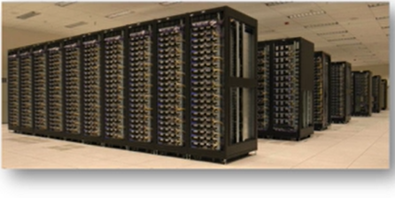
Big Data Jobs/Technologies Hadoop
“The Sexiest Job of the 21st Century”
Thomas H. Davenport and D. J. Patil - Harvard Business Review, October 2012
Hadoop is an open source framework for storing and analyzing massive amounts of distributed, unstructured data
Originally created by Doug Cutting at Yahoo! Here are a couple of examples
Remember this architecture?
Hadoop clusters run on inexpensive commodity hardware so projects can scale-out inexpensively
Fault tolerant – more stuff can break and it will still work
Pushes the processing to the data as opposed to pulling all of the data to the processor and then processing it
Hadoop is now part of Apache Software Foundation
Open source - hundreds of contributors continuously improve the core technology
MapReduce + Hadoop = Big Data core technology

Slide 14
Big Data Technologies Hadoop
How Does Hadoop Work?
Access unstructured and semi-structured data (e.g., log files, social media feeds, other data sources)
Break the data up into “parts,” which are then loaded into a file system made up of multiple nodes running on commodity hardware using HDFS (Hadoop Distributed File System
Each “part” is replicated multiple times and loaded into the file system for replication and failsafe processing
A node acts as the Facilitator and another as Job Tracker
Jobs are distributed to the clients, and once completed, the results are collected and aggregated using MapReduce

Slide 15
Big Data Technologies Hadoop
Hadoop Technical Components
Hadoop Distributed File System (HDFS)
Name Node (primary facilitator)
Secondary Node (backup to Name Node)
Job Tracker
Slave Nodes (the grunts of any Hadoop cluster)
Additionally, Hadoop ecosystem is made up of a number of complementary sub-projects: NoSQL (Cassandra, Hbase), DW (Hive), …

Slide 16
Big Data Technologies Hadoop - Demystifying Facts
Hadoop consists of multiple products-a family of open source products
Hadoop is open source but available from vendors too
Hadoop is an ecosystem, not a single product
HDFS is a file system, not a DBMS
Hive resembles SQL but is not standard SQL
Hadoop and MapReduce are related but not the same
MapReduce provides control for analytics, not analytics
Hadoop is about data diversity, not just data volume
Hadoop complements a DW; it’s rarely a replacement
Hadoop enables many types of analytics, not just Web analytics

Slide 17
Big Data Technologies MapReduce
MapReduce distributes the processing of very large multi-structured data files across a large cluster of ordinary machines/processors
Goal - achieving high performance with “simple” computers
Developed and popularized by Google
Good at processing and analyzing large volumes of multi-structured data in a timely manner
Example tasks: indexing the Web for search, graph analysis, text analysis, machine learning
A programming model, not a language.
Designed by and for programmers rather than business users

Slide 18
Big Data Technologies MapReduce
How does
MapReduce
work?

Slide 19
Big Data And Data Warehousing
What is the impact of Big Data on DW?
Big Data and RDBMS do not go nicely together
Will Hadoop replace data warehousing/RDBMS?
Use Cases for Hadoop
Hadoop as the repository and refinery
Hadoop as the active archive
Use Cases for Data Warehousing
Data warehouse performance-refined query optimizers
Fantastic when data is collected cleansed and integrated to provides value
Interactive BI tools

Slide 20
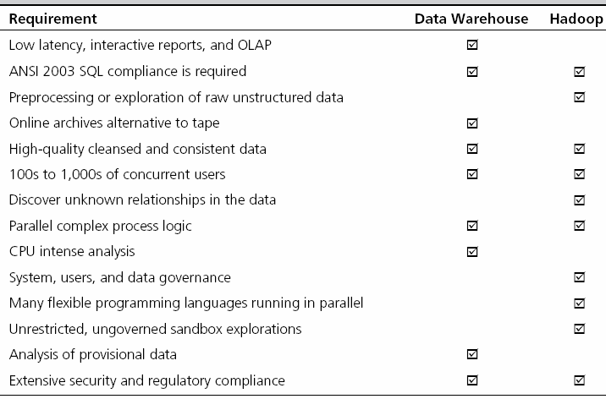
Hadoop versus Data Warehouse When to Use Which Platform

Slide 21
Coexistence of Hadoop and DW
Use Hadoop for storing and archiving multi-structured data
Use Hadoop for filtering, transforming, and/or consolidating multi-structured data
Use Hadoop to analyze large volumes of multi-structured data and publish the analytical results
Use a relational DBMS that provides MapReduce capabilities as an investigative computing platform
Use a front-end query tool to access and analyze data

Slide 22
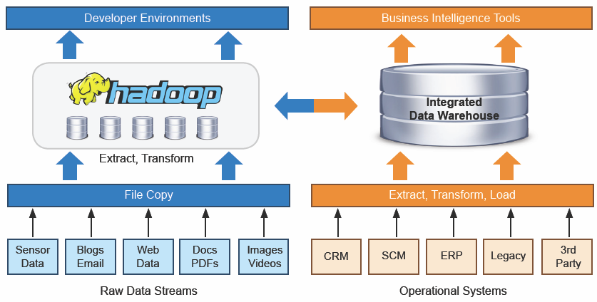
Coexistence of Hadoop and DW
Source: Teradata

Slide 23
Big Data Vendors
Big Data vendor landscape is developing very rapidly
A representative list would include
Claudera - claudera.com
MapR – mapr.com
Hortonworks - hortonworks.com
Also, IBM (Netezza, InfoSphere), Oracle (Exadata, Exalogic), Microsoft, Amazon, Google, …
Software,
Hardware,
Service, …

Slide 24
Data Scientist
“The Sexiest Job of the 21st Century”
Thomas H. Davenport and D. J. Patil
Harvard Business Review, October 2012
Data Scientist = Big Data guru
One with skills to investigate Big Data
Very high salaries, very high expectations
Where do Data Scientists come from?
M.S./Ph.D. in MIS, CS, IE,… and/or Analytics
There is not a specific degree program for DS!
PE, PML, … DSP (Data Science Professional)

Slide 25
Skills That Define a Data Scientist

Slide 26
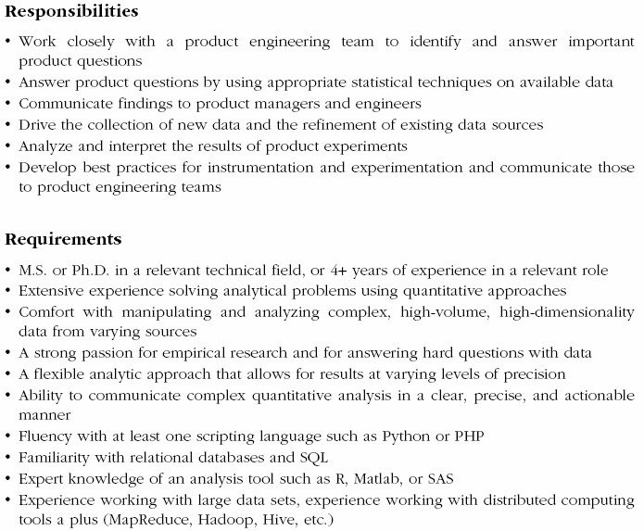
A Typical Job Post for Data Scientist

Slide 27


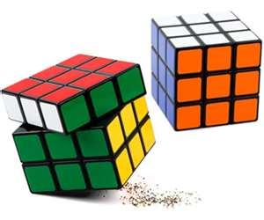



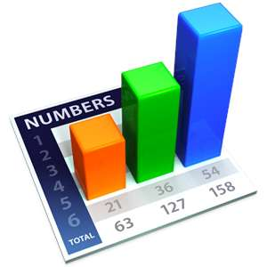
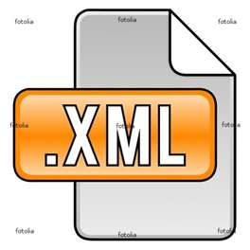

Transforming Data into Information
SharePoint Portal
DW
DM
DM
Return…

